Slide 1
Multistage Domino Logic of AND Gate
K Sai Akhil
MTech VLSI Design
VLD26006
CMOS Integrated Circuit’s
Amrita Vishwa Vidyapeetham
Amritapuri Campus

Slide 2
Problem Statement
Propagation delay estimation of a multi-stage Domino chain using Elmore delay models and SPICE.

Slide 3
Objective
To design and simulate a multi-stage Domino logic chain using SPICE.
To develop equivalent RC tree models for the individual stages and estimate propagation delay using the Elmore delay model.
To calculate the propagation delay of the complete Domino chain by considering the resistance and capacitance contributions of each stage.
To analyze the rising and falling propagation delays and identify the critical timing path.
To compare the analytically estimated delays with SPICE simulation results and evaluate the accuracy of the Elmore delay model.

Slide 4
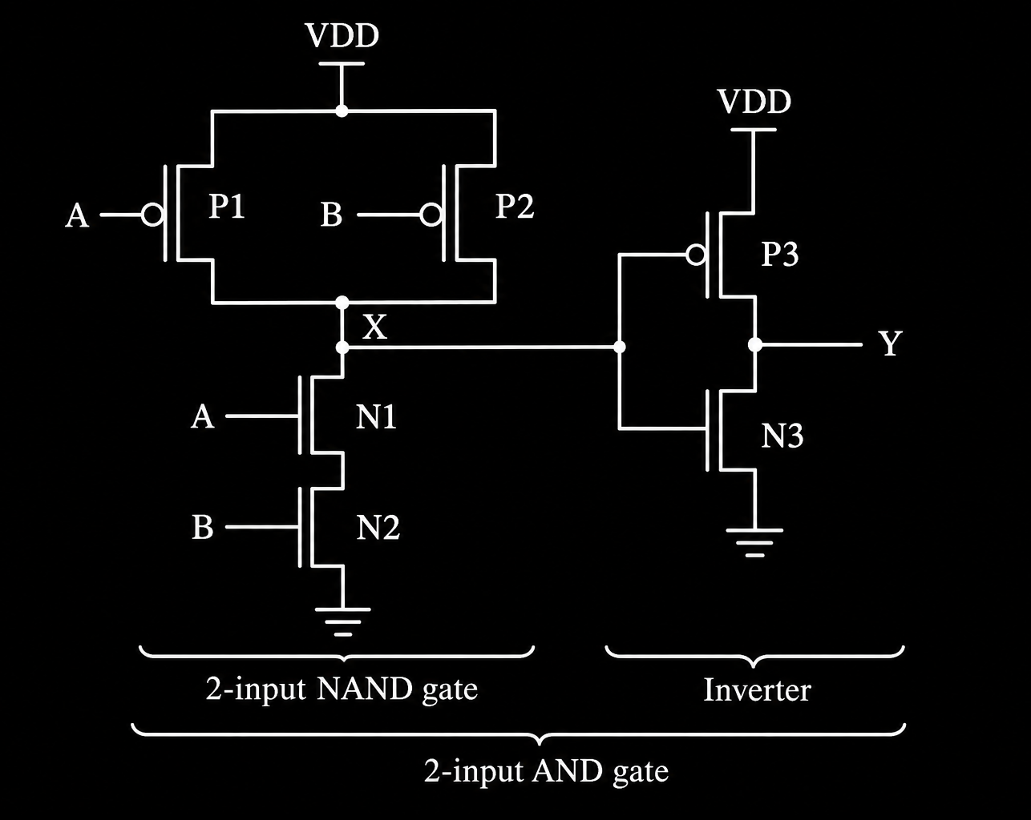
Static CMOS
Static CMOS Logic: Static CMOS logic uses complementary PMOS pull-up and NMOS pull-down networks to implement logic functions. It provides reliable, full-swing logic outputs and retains its logic state as long as power is supplied.
Limitations of Static CMOS Logic: For complex logic functions, static CMOS may require a large number of transistors, increasing circuit area and parasitic capacitance. The additional transistor networks and capacitive loads can increase propagation delay and dynamic power consumption.
Introduction to Domino Logic: To address these limitations, domino logic uses dynamic CMOS techniques with a clock-controlled precharge PMOS, an NMOS evaluation network, and an output inverter. This structure can reduce transistor count and simplify complex logic implementation.
Advantages of Domino Logic over Static CMOS: Domino logic can offer higher operating speed, lower input capacitance, reduced transistor count, and smaller area for suitable complex logic functions. However, it requires a clock, careful timing design, and management of dynamic-node leakage and charge-sharing effects.

Slide 5
What is Domino Logic?

Slide 6
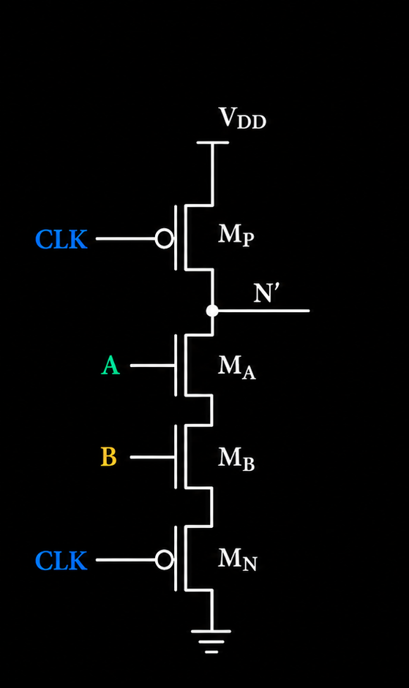
Dynamic CMOS:
How do we get Output using Dynamic Logic
Dynamic logic of and gate
Phase A: Precharge — CLK = 0
Precharge PMOS : ON
Its gate is LOW, so it provides a path from VDD to N’.
Footer NMOS :OFF
Its gate is LOW, so the evaluation network has no conducting path to ground through the footer.
The N’ sees a HIGH Value.
Phase B:
Phase B: Evaluation — CLK = 1
Now the circuit changes state.
M P turns OFF, disconnecting the precharge supply.
M N turns ON, enabling the path to ground.
M A and M B depend on inputs A and B.
Therefore Evalution of Y=~(A.B)

Slide 7
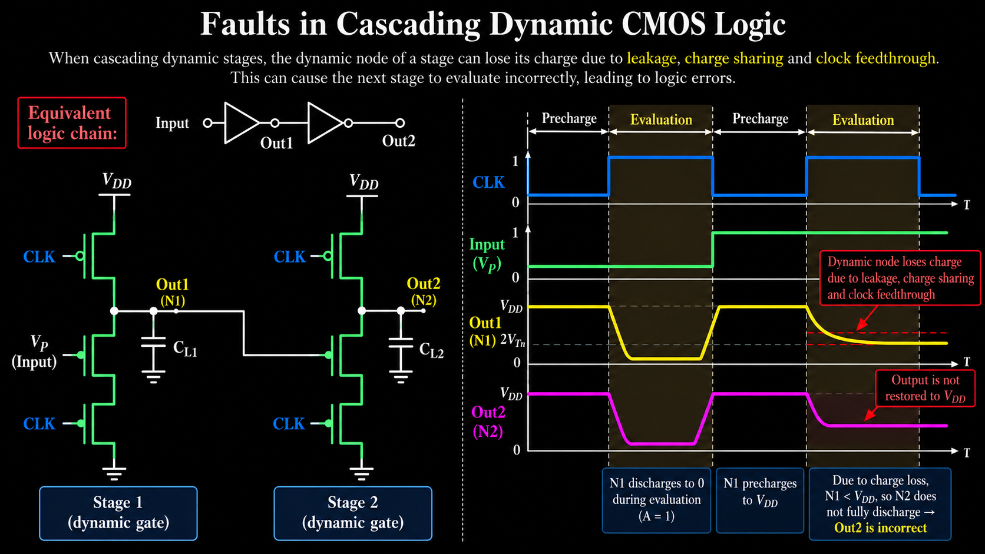

Slide 8
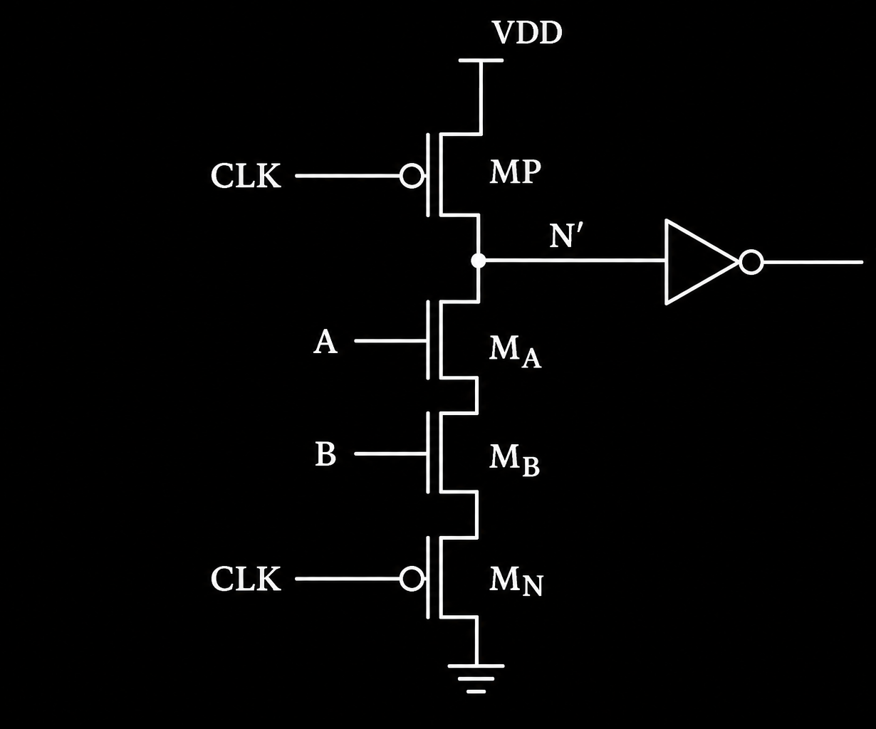
Domino Logic of AND Gate:
How do we get Output using domino Logic
Domino logic of and gate
Phase A: Precharge — CLK = 0
Precharge PMOS : ON
Its gate is LOW, so it provides a path from VDD to N’.
Footer NMOS :OFF
Its gate is LOW, so the evaluation network has no conducting path to ground through the footer.
The inverter sees a HIGH input, so Y=0
Phase B:
Phase B: Evaluation — CLK = 1
Now the circuit changes state.
M P turns OFF, disconnecting the precharge supply.
M N turns ON, enabling the path to ground.
M A and M B depend on inputs A and B.
Therefore Evalution of Y=A.B

Slide 9
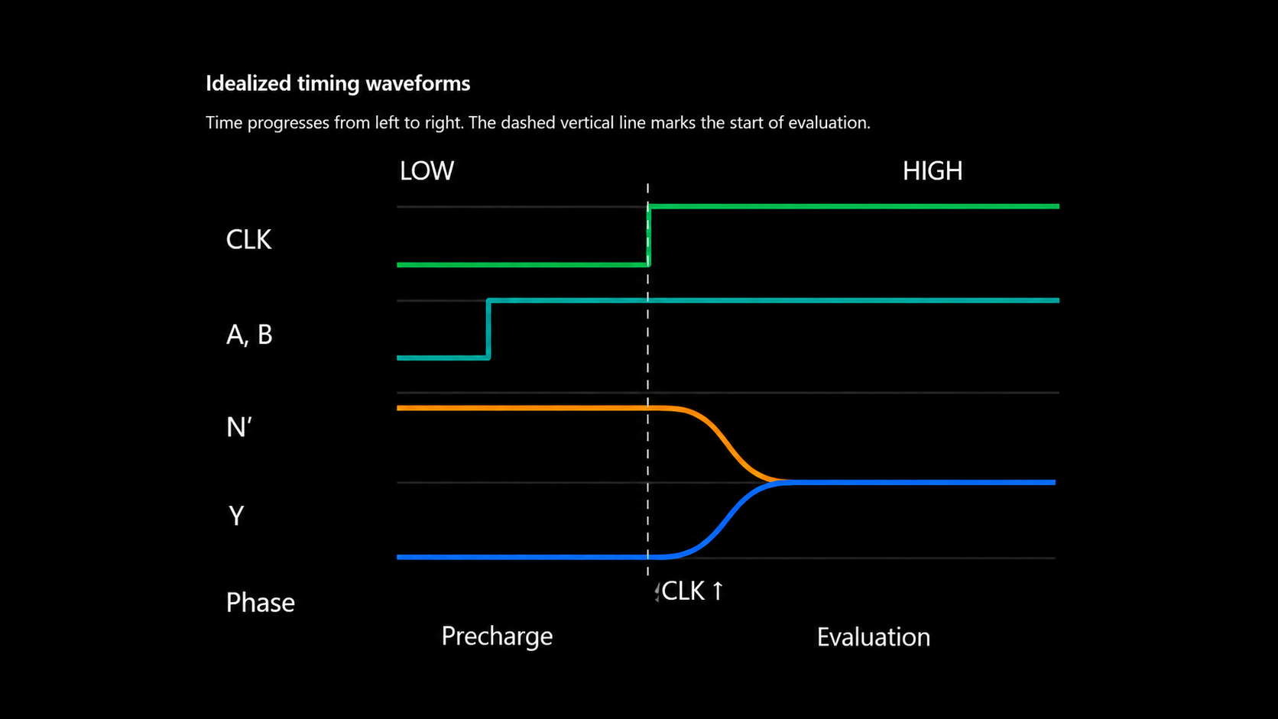

Slide 10
Elmore Delay Calculation

Slide 11
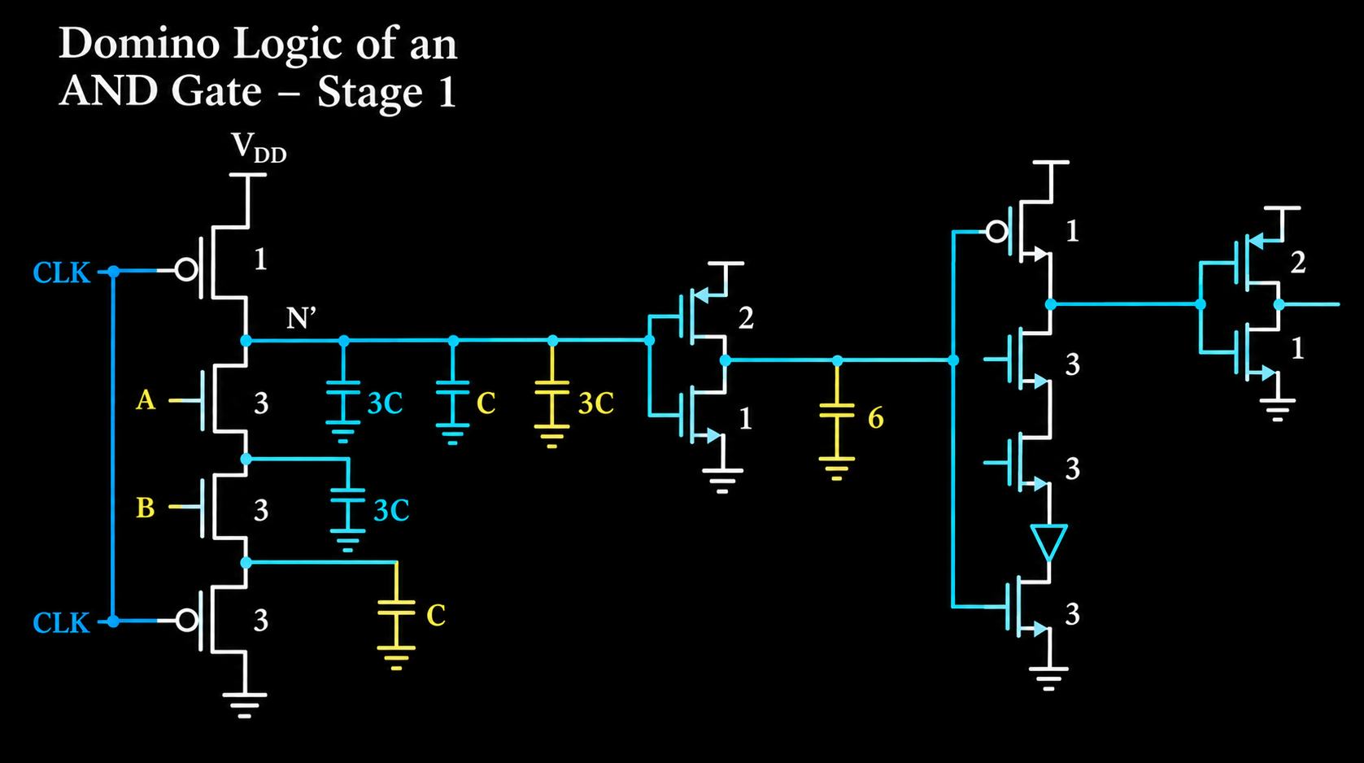
D
3 C

Slide 12
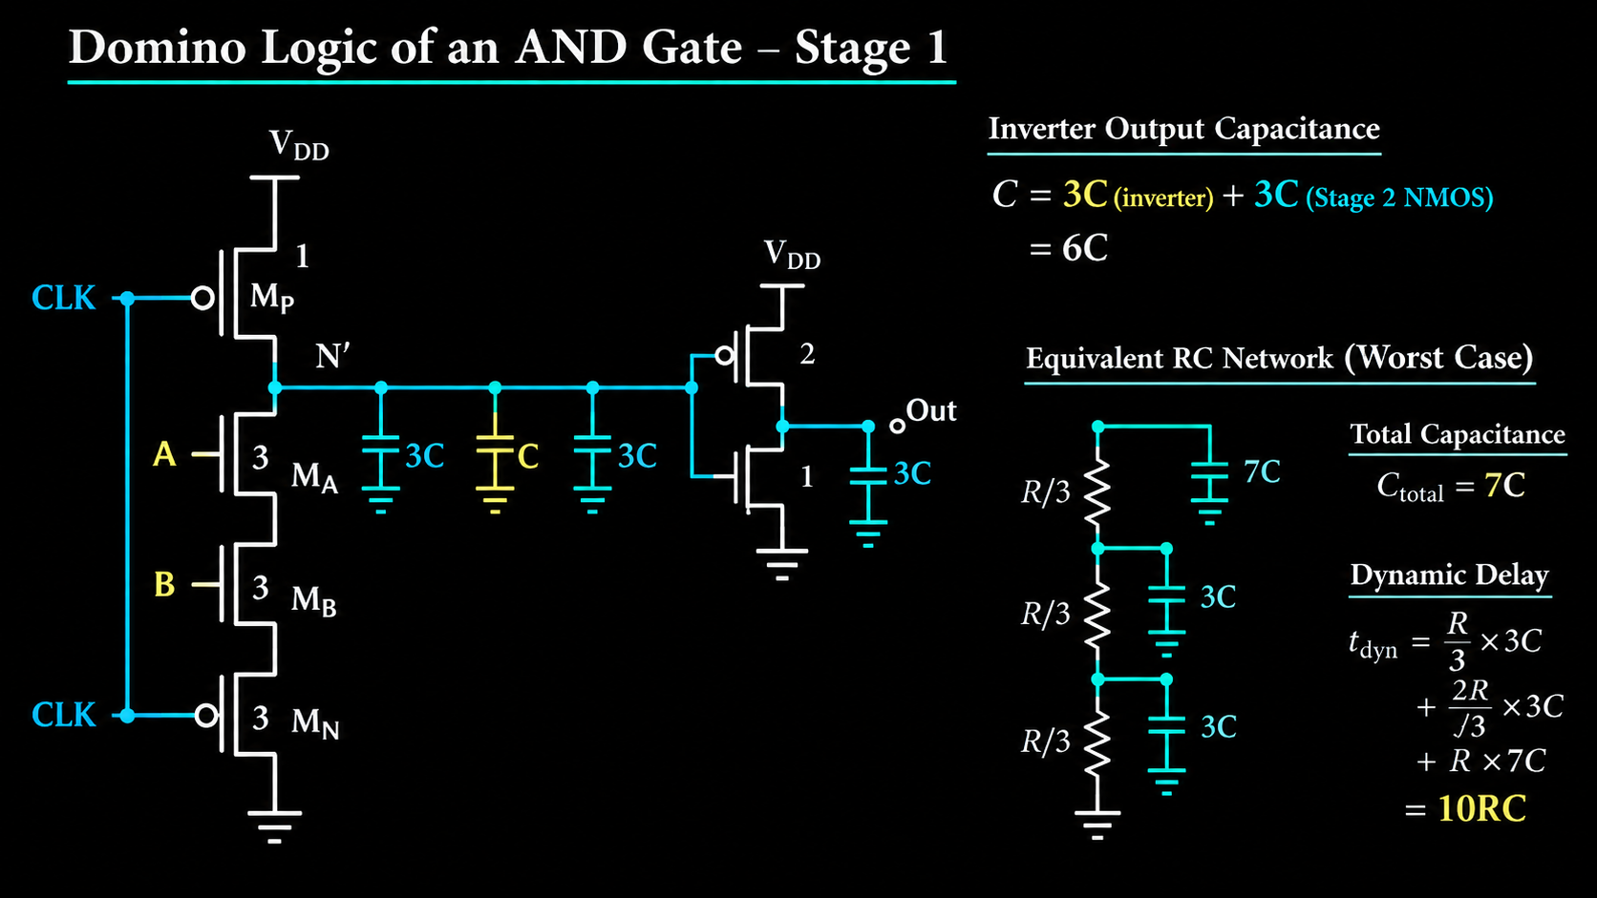

Slide 13
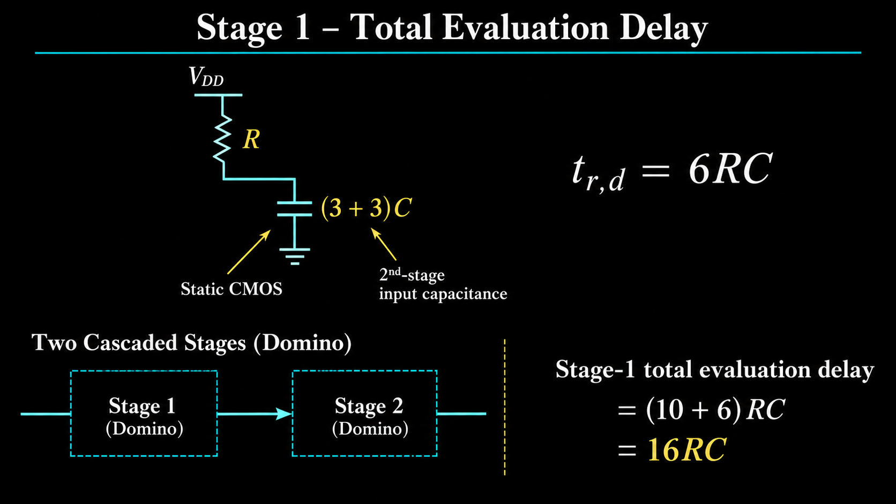

Slide 14
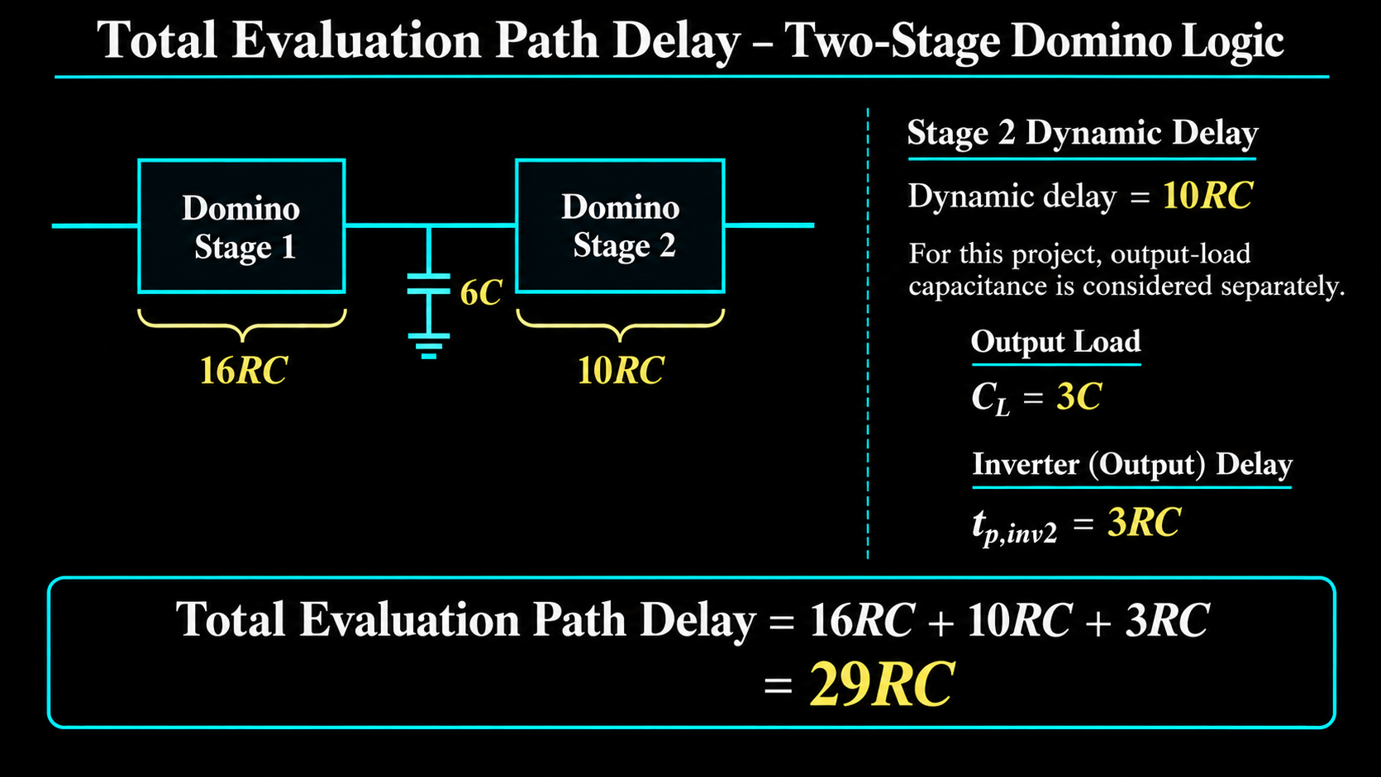

Slide 15
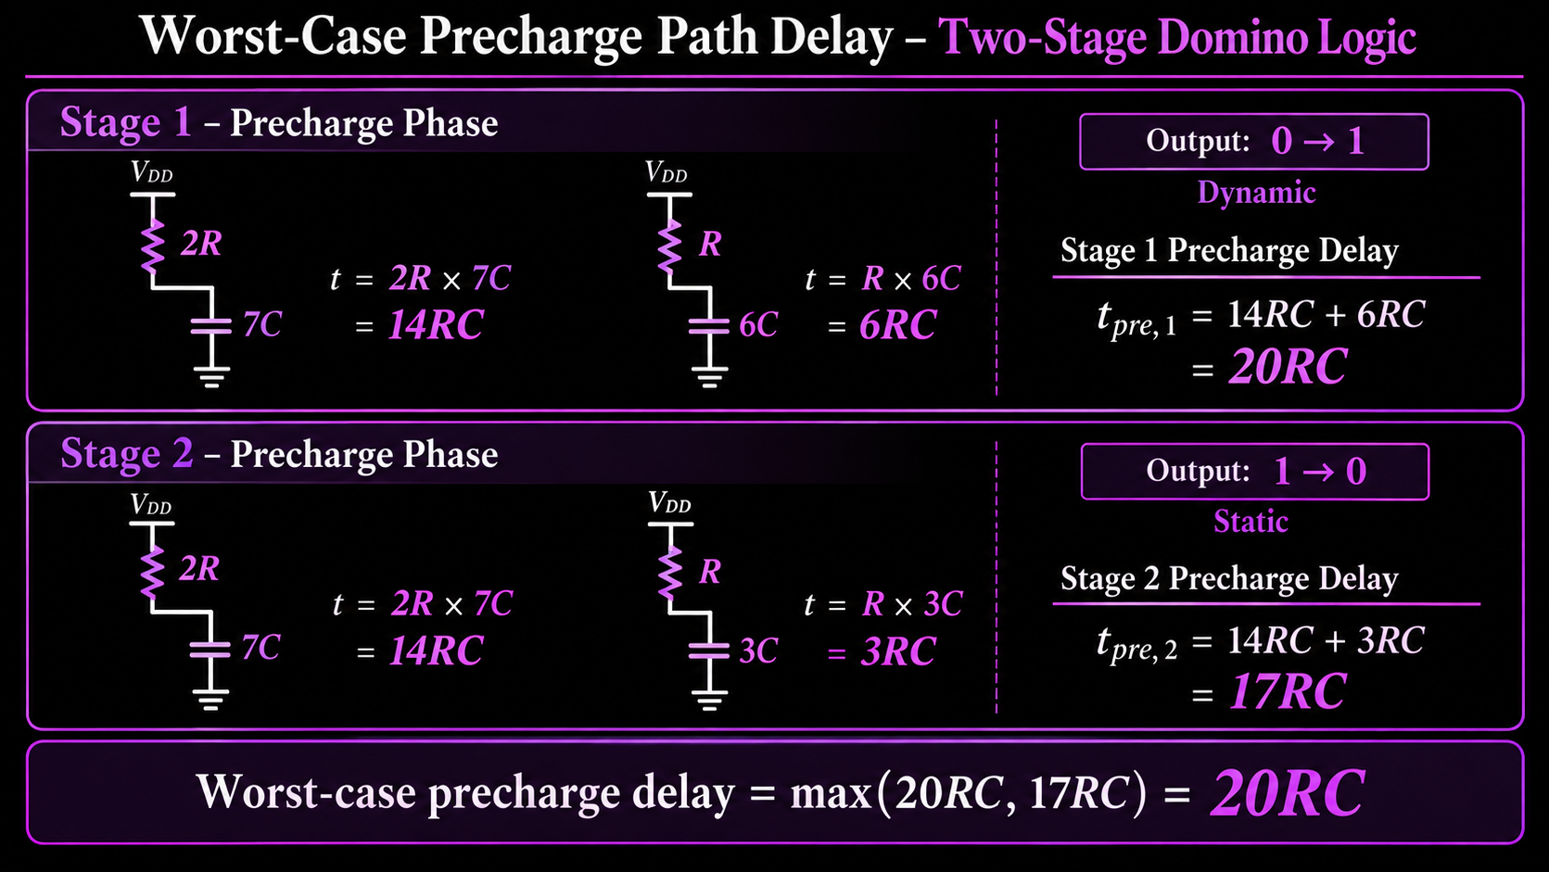

9
GND
GND

Slide 16
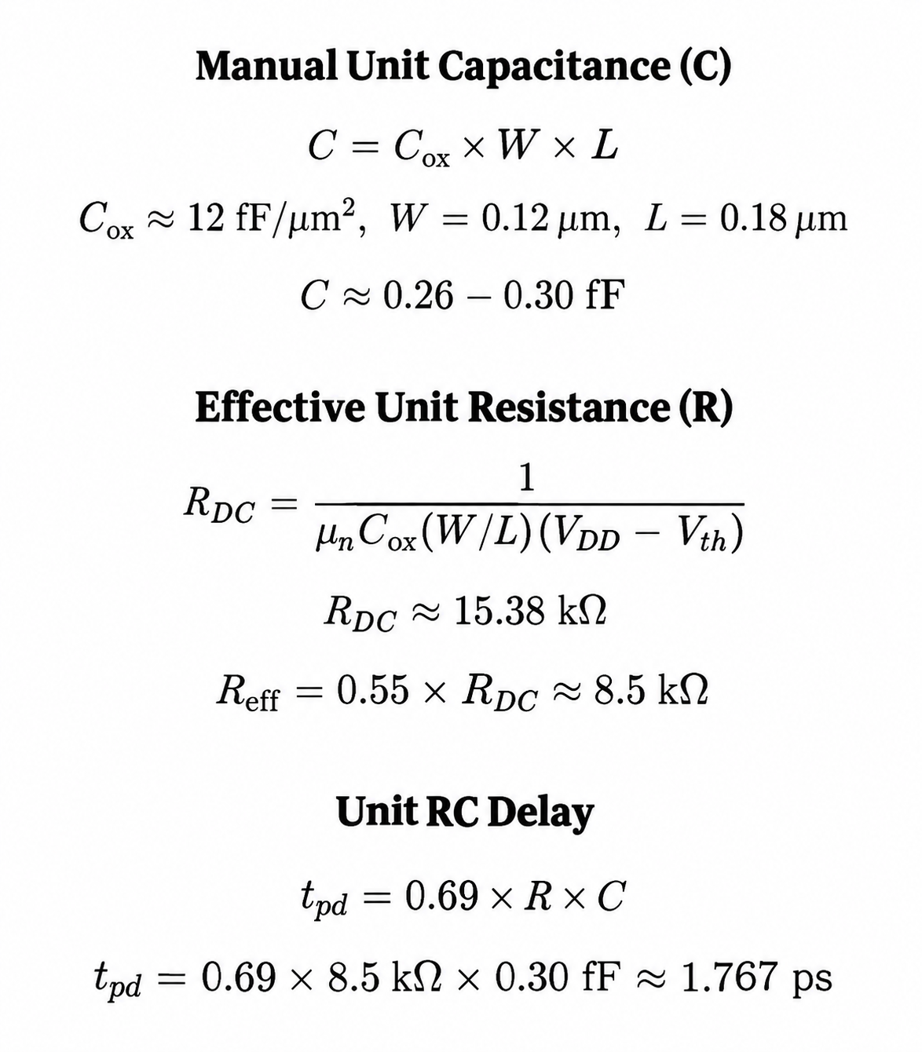
Manual Calculation of Resistance and Capacitance:
VDD = 1.8V
Vth = 0.4 V
unCox = 300 uA/V^2

Slide 17
Elmore Delay Calculation:
For Clk to Stage 1 Evaluation : 16RC = 16 * 1.767 ps = 28.272 ps.
For Stage 1 to Stage 2 Evaluation : 10RC = 10 *1.767 ps = 17.67 ps.
From Clk to Output: 29RC = 29 * 1.767 ps = 51.243 ps.
Pre Charge Delay : 20RC = 20 * 1.76 ps = 35.2 ps.

Slide 18
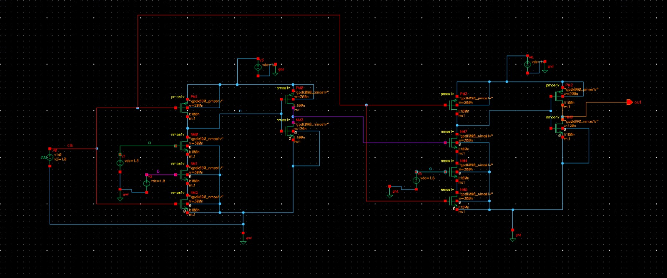
Virtuoso Schematic of Two Stage And gate:

Slide 19
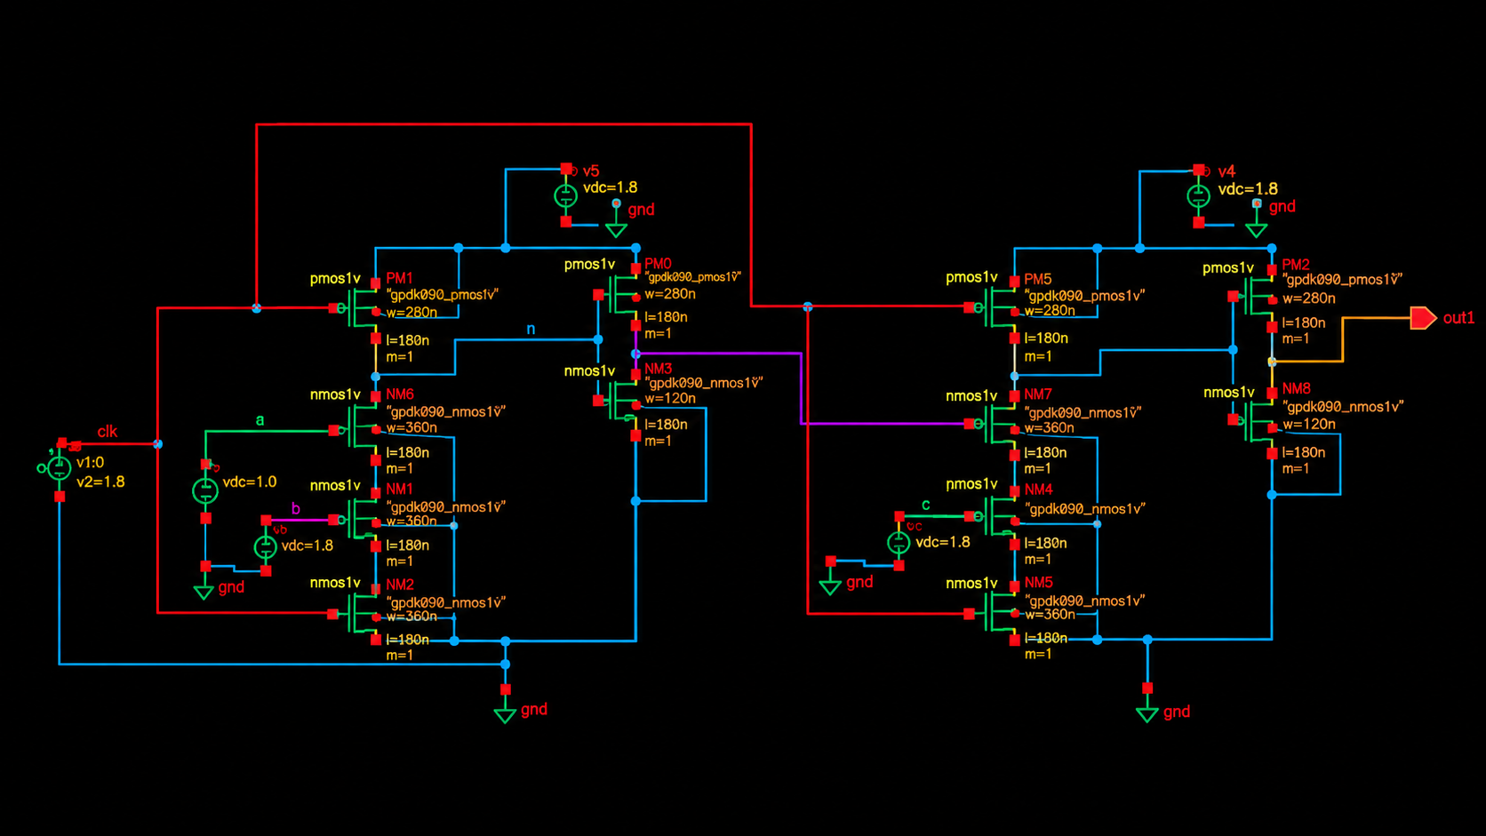

Slide 20
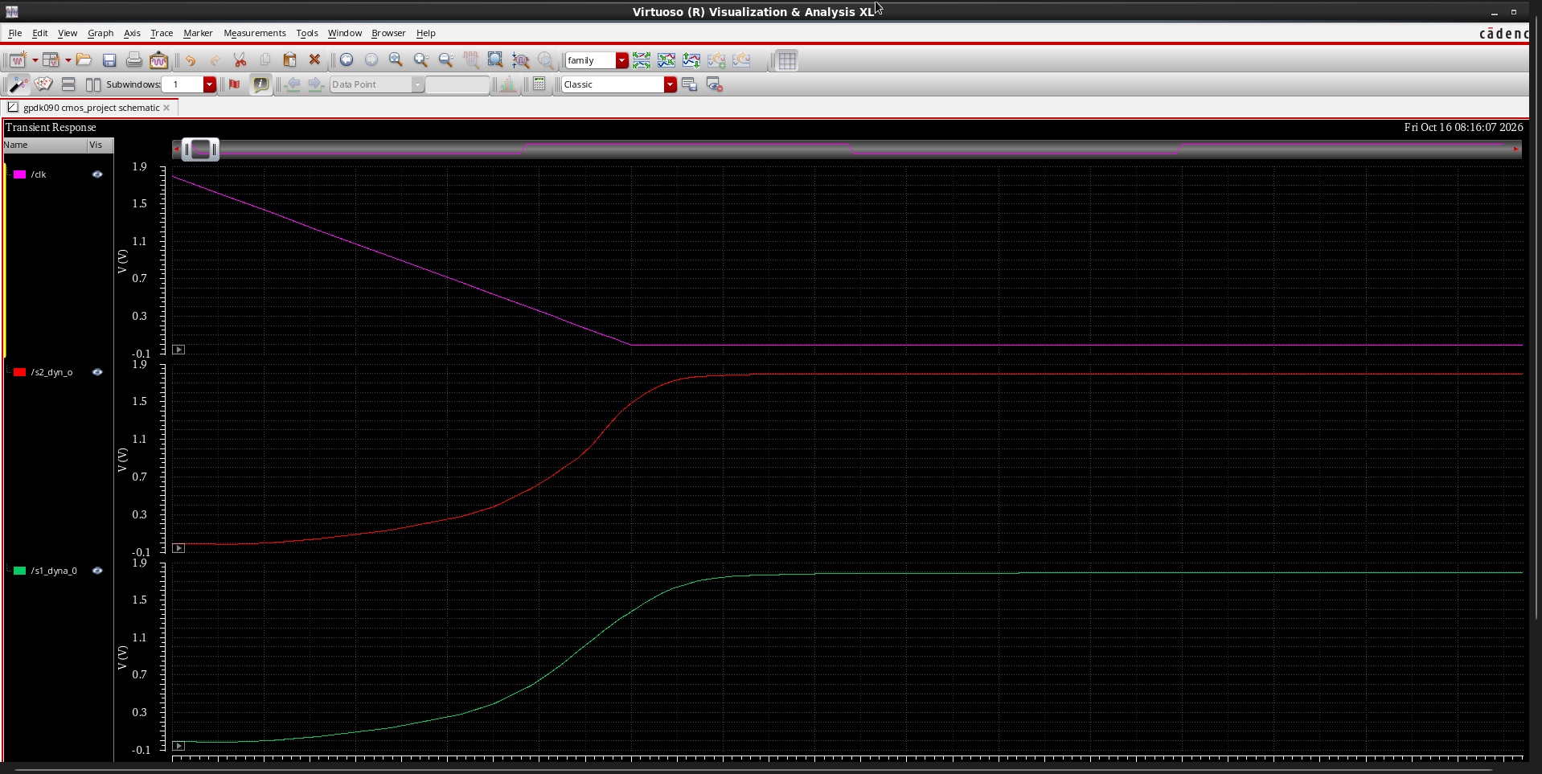
PreCharge Phase:

Slide 21
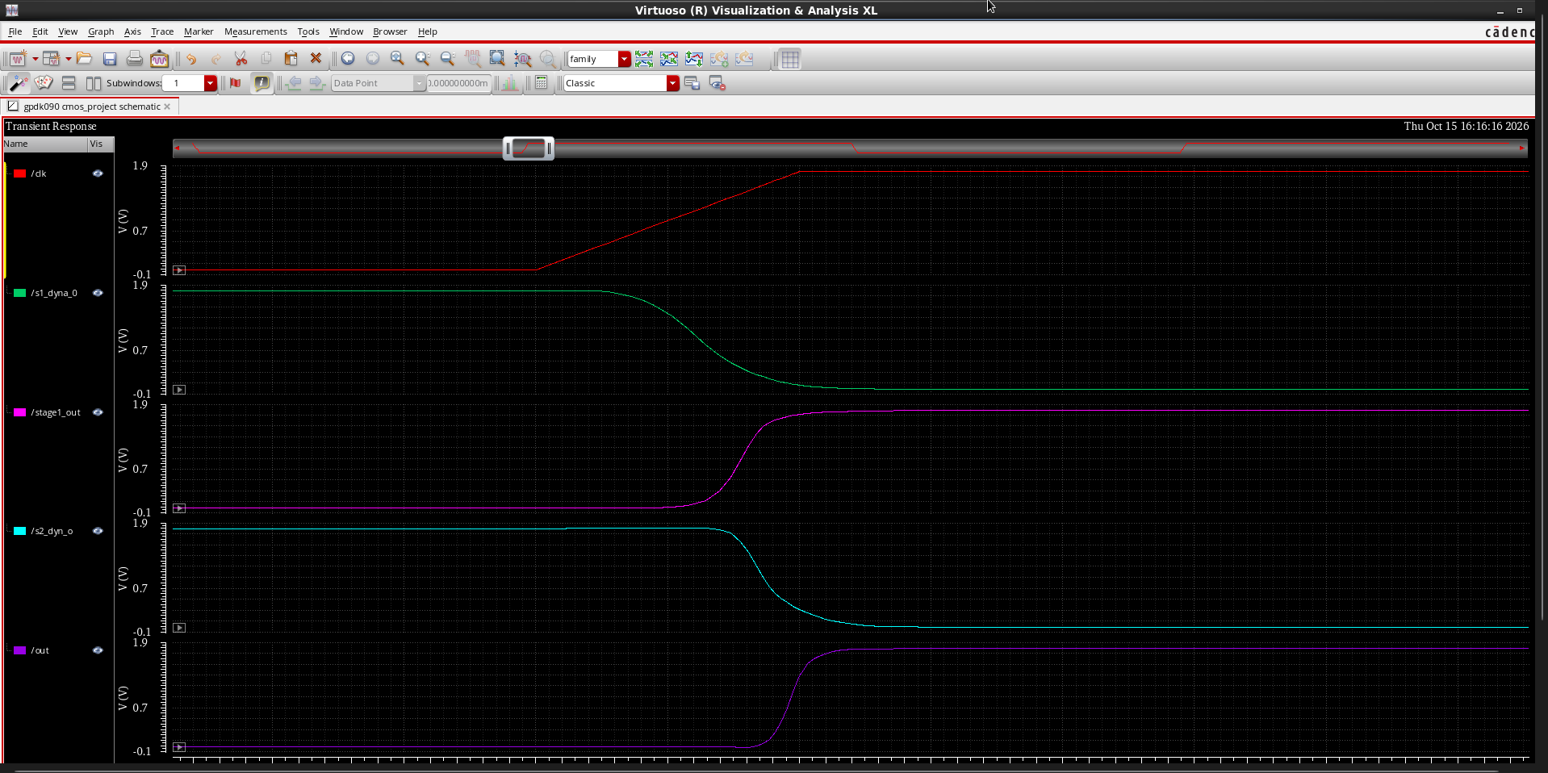
Evaluation Phase:

Slide 22
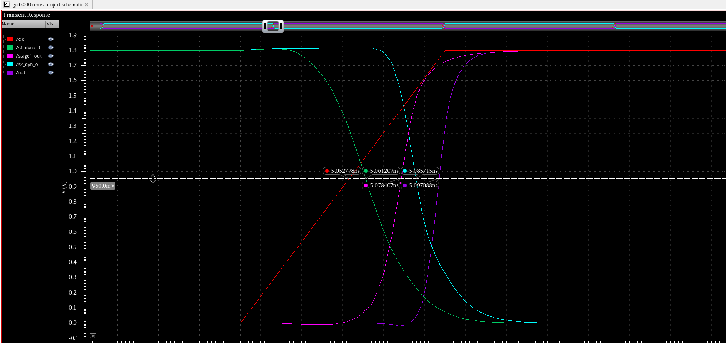
Evaluation Phase:

Slide 23
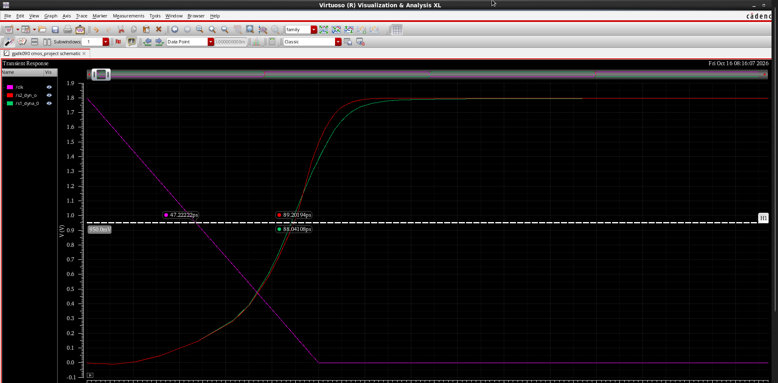
Pre Charge Phase

Slide 24

Output:
Supply voltage: 1.8 V
Clock period: 20 ns (50 MHz)
Precharge phase (CLK = 0): Dynamic node charges HIGH; output is LOW.
Evaluation phase (CLK = 1): Dynamic node discharges through the NMOS network when all inputs are HIGH, driving the output HIGH.
Observed output: Swings between approximately 0 V and 1.8 V, following the clock.
Transient response: Output transitions are observed at approximately 10 ns, 20 ns, and 30 ns.

Slide 25
Delay Estimation from virtuoso:
Stage 1 dynamic node delay (/clk to /s1_dyna_0): 8.43 ps.
Stage 1 inverter delay (/s1_dyna_0 to /stage1_out): 17.20 ps.
Stage 1 total evaluation delay (/clk to /stage1_out): 25.63 ps.
Stage 2 dynamic node delay (/stage1_out to /s2_dyn_o): 7.31 ps.
Stage 2 inverter delay (/s2_dyn_o to /out): 11.37 ps.
Stage 2 total evaluation delay (/stage1_out to /out): 18.68 ps.
Total clock-to-output evaluation delay (/clk to /out): 44.31 ps.
Precharge delay : 40.821 ps.

Slide 26
Elmore Delay vs. Virtuoso Simulation Results
Delay Parameter | Elmore Delay (ps) | Simulated Delay (ps)
Stage 1 Total Evaluation Delay | 28.27 | 25.63
Stage 2 Total Evaluation Delay | 17.67 | 18.68
Total Clock-to-Output Delay | 51.24 | 44.31
Pre Charge Delay | 35.2 | 40.821

Slide 27
Conclusion:
Designed and simulated a two-stage Domino logic AND gate in Cadence Virtuoso and verified its precharge and evaluation phases using transient waveforms.
The total clock-to-output delay was 51.24 ps (Elmore estimate) and 44.31 ps (simulation), with an absolute difference of 6.93 ps.
The percentage difference was 13.53% relative to the Elmore estimate, indicating that the analytical model overestimated the simulated delay.
Elmore delay analysis provides a useful first-order timing estimate, while transistor-level simulation captures more realistic device behavior and circuit parasitic effects.

Slide 28

Thank you
K Sai Akhil
VLD26006

